Slide 1
Time Series Fundamentals
ACFs, PACFs and ARIMA Models
Part 2

Slide 2
Time to Specify the ARIMA Model
So in this course I emphasize the trial and error method of ARIMA modeling. I do this because it helps students understand how the mechanisms work in terms of determining the best ARIMA model. And because I am just always a bit suspicious of automated optimization procedures. Trust but verify!
Note that there are procedures in a number of platforms like SPSS, SAS, R and Python that will sniff out the best model. Useful when you are trying to work efficiently.

Slide 3
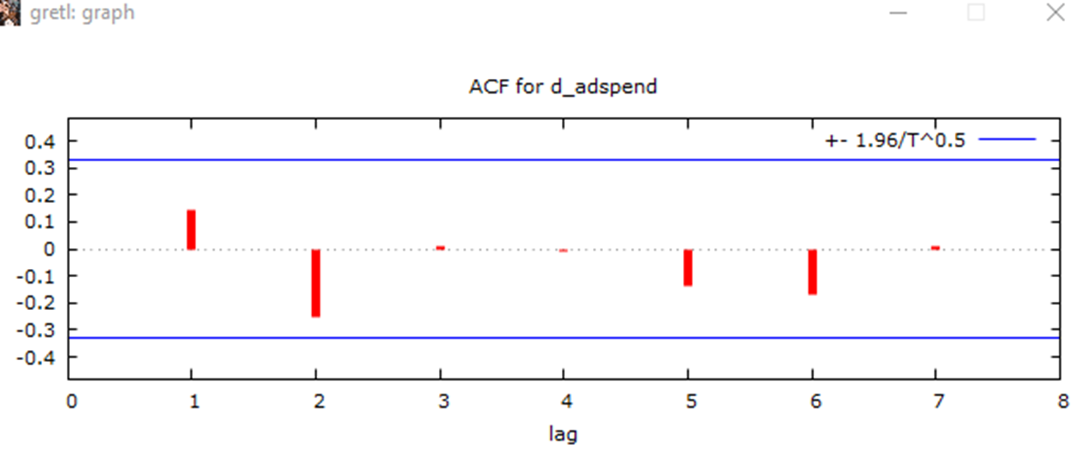
Time to Specify the ARIMA Model
Note that you can sometimes examine the ACF plot of the constant mean time series and figure out a good starting point.
For example, if the red bar goes above the significance blue line (positive), that means that at that particular lag there may be an autoregressive process.
If the red bar goes below the significance blue line (negative) then that suggests a moving average process at that lag.

Slide 4
Time to Specify the ARIMA Model
You can learn more about the art of interpreting ACF plots at these websites:
https://people.duke.edu/~rnau/411arim3.htm or
https://onlinecourses.science.psu.edu/stat510/node/64
.

Slide 5
Time to Specify the ARIMA Model
Sadly, there are no red bars that cross the blue significance line suggesting MA or AR processes, so we will just have to guess.
.

Slide 6
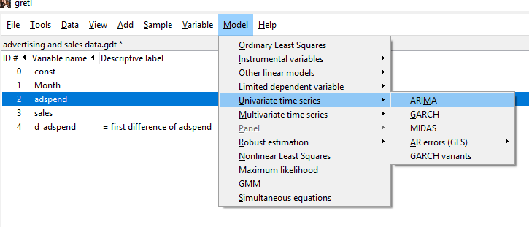
Time to Specify the ARIMA Model
First fire up the ARIMA model in GRETL…
.

Slide 7
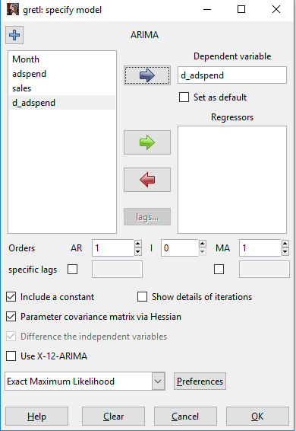
Time to Specify the ARIMA Model
Move the differenced adspend variable into the dependent variable box.
Next specify the model. I am going to go with a first order autoregressive and first order moving average model ARIMA (1,0,1).
No need to specify anything other than a zero for the I or differencing component – I have already differenced the data and differencing it further could damage the integrity of the results.
.

Slide 8
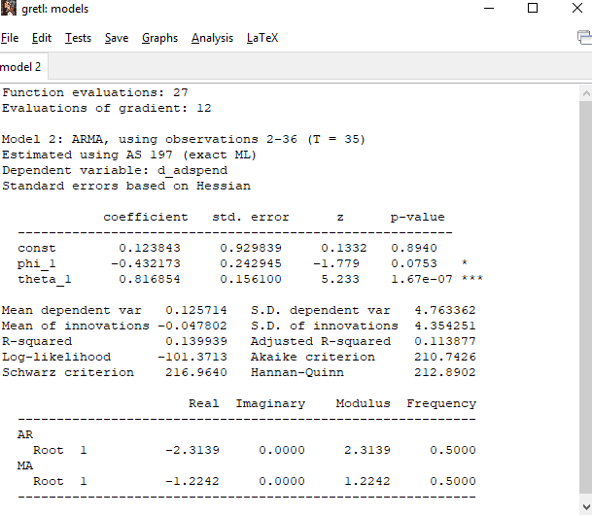
Time to Specify the ARIMA Model
Here is my result for the ARIMA(1,0,1) model.
Note that the coefficient table is very similar to a regression coefficient table.
The phi_1 term is the one for a first order autoregressive term. Note that the pvalue means it is not significant – it has not detected any first order AR processes in the data in this model.

Slide 9
Time to Specify the ARIMA Model
Here is my result for the ARIMA(1,0,1) model.
The theta_1 term is the one for a first order moving average term. Note that the pvalue means it is significant – it has detected a first order MA process in the data in this model.

Slide 10
Time to Specify the ARIMA Model
Let’s look at some of the goodness of fit metrics.
The adjusted R square for the model is .113 which means about 11.3% of the variance in the dependent variable is accounted for by the model.

Slide 11
Time to Specify the ARIMA Model
Let’s look at some of the goodness of fit metrics.
The Akaike criterion (AIC), the Scharwz criterion (Baysian Information criterion or BIC) and the Hannan-Quinn metrics are all relative goodness of fit metrics.
The idea is to produce a number of ARIMA models and compare these three metrics.
The smaller the metric here, the better the fit! Keep this in mind!

Slide 12
Time to Specify the ARIMA Model
Let’s look at some of the goodness of fit metrics.
Note that the BIC and Hannan-Quinn are more conservative in that they penalize the model more for additional variables (e.g. loss of degrees of freedom).
The smaller the metric here, the better the fit! Keep this in mind!

Slide 13
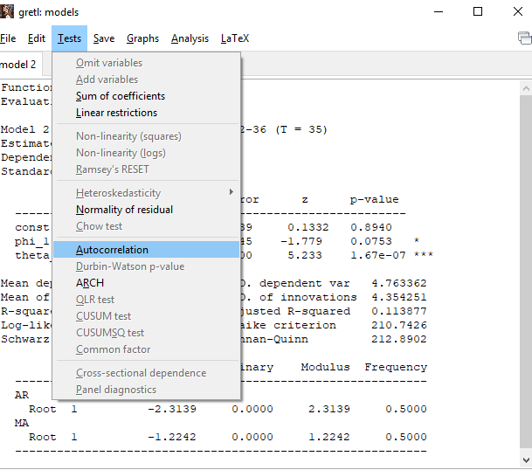
Time to Specify the ARIMA Model
Once the model is specified then some further additional examination is in order.
Pulling down the Tests menu from the ARIMA run we see the autocorrelation choice.
This is going to run the Ljung-Box Q statistic. It measures the amount of autocorrelation left in the residuals of the model.

Slide 14
Time to Specify the ARIMA Model
Next you will see a lag dialog box with a lag parameter for the test. Try it with the default value.
If GRETL doesn’t like the value and gives you an error message, try it again and jack up the lag order by one. Keep trying until it works. It’s complaining about the number of degrees of freedom needed to perform the test.

Slide 15
Time to Specify the ARIMA Model
Here is the Ljung-Box test.
The null hypothesis is that there is no evidence of serial autocorrelation in the residuals.
The alternative hypothesis is that there is serial autocorrelation in the residuals.
This is looking to see if there is any variance left after the model is done that might be better explained by another model.
That is, did you leave any “food on your plate” with that model?

Slide 16
Time to Specify the ARIMA Model
The idea is that you want this p value to be > .05, suggesting that you have not left any variance left to explain.
So the failure to reject the null hypothesis is a good thing!

Slide 17
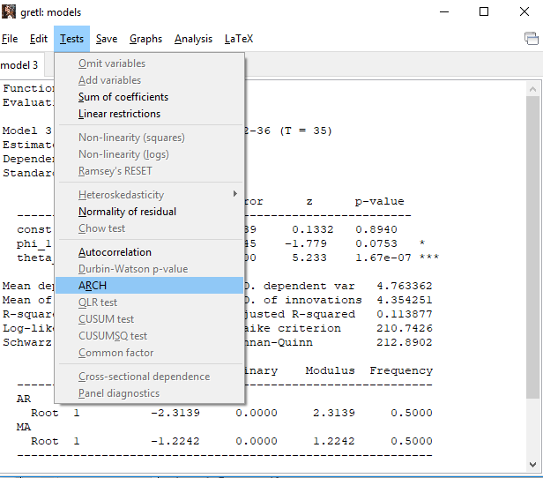
Time to Specify the ARIMA Model
The final thing here is to see if there is evidence of constant variance in the time series. This can be detected by applying the ARCH test to the residuals.
So let’s try this by selecting the ARCH test from the menu

Slide 18
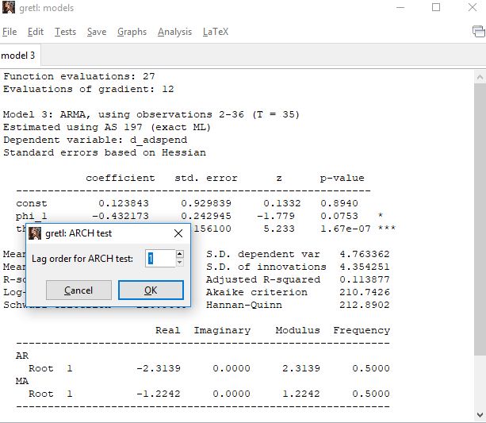
Time to Specify the ARIMA Model
Once again a lag parameter is specified.
Try to use the default. If GRETL complains with an error message, increase the lag by one and try again.

Slide 19
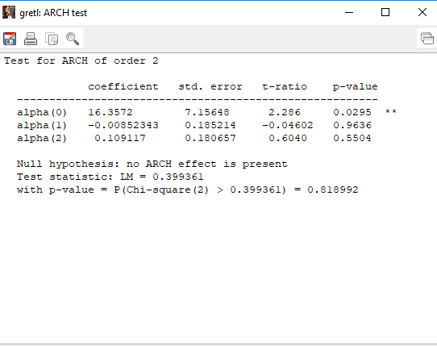
Time to Specify the ARIMA Model
Here is the ARCH test.
The null hypothesis is that there is no evidence of non-constant variance across time.
The alternative hypothesis is that there is non-constant variance across time in the data set.
You want this test to have a p value that is > .05 suggesting there is no evidence of non-constant variance in the model.

Slide 20
Time to Specify the ARIMA Model
If the p value for this test is <= .05 then there is evidence of non-constant variance across time.
This means you need to apply a GARCH model to the data. We won’t be covering this model in this course but I suspect you will get exposure to it in your next time series adventure in the next course.

Slide 21
Step 7: Sample Size and Power
Most stat textbooks recommend a minimum of 50 observations for working on time series models…
Technically discussions of power and time series often do not mix very easily. The more cases one has (see #1 above) the more power the ARIMA model will have to find statistically significant AR and MA processes.

Slide 22
Step 8: Assumptions of the Test
The two most classic assumptions of ARIMA models are:
The time series data is at least weakly stationary
Constant mean over time
Constant variance over time
Homoskedasticity of residuals

Slide 23
Step 9: Notes
Note that the interpretation of the ACF and PACF are subjective to some degree. Note that in my example I ignored the seasonality component of sales in those diagnostic plots. There is a non-trivial amount of discretion often involved in forming some types of time series models.
There are other software packages (the freeware GRETL for example) that have more complex time series models available

